Slide 1
Docker
What is docker
Docker container
Docker image
Container lifecycle
How to the build the docker image
Docker volumes
Docker compose
Docker network
Docker swarm

Slide 2
Before Containers
Everytime got through same steps to deploy the application-
Make VM ready, install the code and configure it on VM, maintain the VM as well.
Problems-
Server updates were missed
Intermittent errors
Multiple layers to troubleshoot
To overcome these Virtualization

Slide 3

Virtual Machine
VM-
OS- Linux
Memory 18GB
Hardware capacity 300GB
Virtual Machine is a software program that emulates the functionality of physical hardware or computing system.
It makes it possible to run what appears to be on many separate computers on the hardware of a single computer.
Host Machine- Windows OS

Slide 4
Virtualization
VM
VM
VM
App1
App1
App1
It’s a technique to import one or more guest operating systems on top of host operating systems.
Hypervisor-
It is sw used to create and run the VM on the Host os
It is a virtual machine monitor.
Lib/ Dependency
Lib/ Dependency
Lib/ Dependency
Guest OS
Guest OS
Guest OS
Hypervisor
Host OS
HW

Slide 5
Web Application
VM
Production Server
CentOS
Web Service
Messaging Service
Database Service
VM
Development Server
MAC OS
Libraries And Dependencies
Deploy on three environments
Windows OS
VM
Test Server
Ubuntu OS
Hardware

Slide 6
Challenges
Compatibility
long setup time
developer challenges with new OS
version compatibility
shipping time is longer
compatibility test

Slide 7
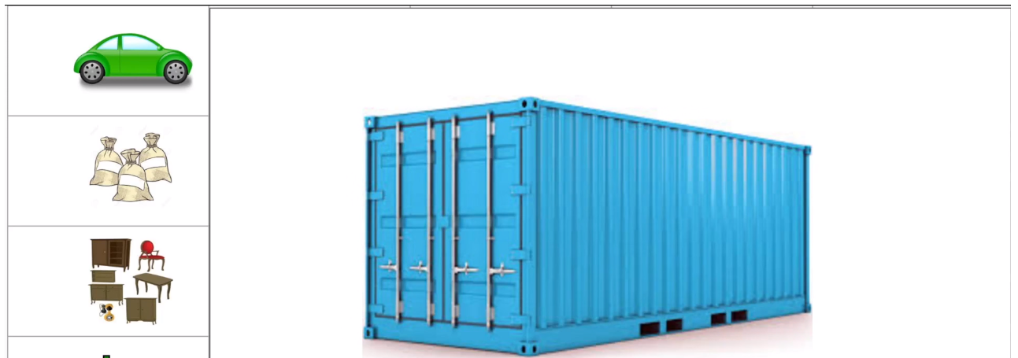
Issues faced to deploy applications on different environments-
Compatibility issue as we are using different environments
Long Setup time
Scalability
Services must be compatible with version of OS
Different environments
Changing versions of services required, will again rise the problem to test them again

Slide 8
Virtualization
1. Same host machine have multiple OS running using VMs
2. In case of failure , recovery, maintenance that is easy.
3. Since need for infrastructure is not much as it is shared , the cost reduces
1. Since we run multiple VMs on a single host machine, the performance degrades.
2. Hypervisors using which we achieve virtualization are not efficient
3. The boot-up process takes comparatively longer

Slide 9
Containerization
Container
Container
Container
App1
App2
App3
It is a form of OS virtualization, wherein we make use of isolated user spaces, called ‘containers’.
These containers used the same shared OS.
E.g. Docker, OpenShift, containerd, Rocket, Docker Swarm
Lib/ Dependency
Lib/ Dependency
Lib/ Dependency
Docker
Host OS
HW

Slide 10
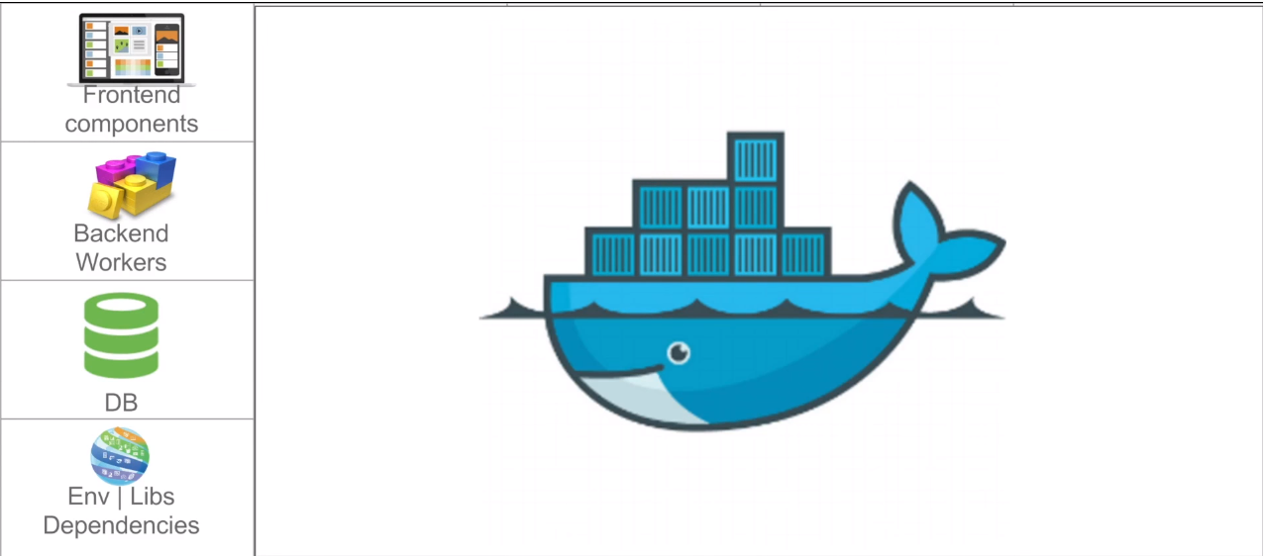
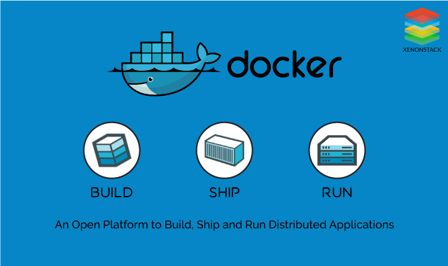
To overcome issues-
To containerize the application
Containerization- Bundling an application together with all its related configuration files. Like libraries, binary files, and dependencies, which are required to run the application in an efficient and bug-free way
Simply, it means bundling up everything that your application needs.

Slide 11
Container
Container
Container
Web Service
Database Service
Messaging Service
Libraries/Bin/Dependencies
Libraries/Bin/Dependencies
Libraries/Bin/Dependencies
Docker
OS
Hardware
Container-
Container is an executable package of software that runs on a top of operating system

Slide 12
Virtual Machine vs Containerization
VM
VM
VM
Container
Container
Container
App1
App1
App1
App1
App1
App1
Lib/ Dependency
Lib/ Dependency
Lib/ Dependency
Lib/ Dependency
Lib/ Dependency
Lib/ Dependency
Guest OS
Guest OS
Guest OS
Hypervisor
Docker
Host OS
Host OS
HW
HW

Slide 13
Hypervisor-
The software that facilitates virtualization.
They take physical resources and divide them up so that virtual environments can use them.
Containerization
1. Runs on same host OS
2. Lower Space utilization, in MBs. Lightweight
3. Faster boot time compared to VMs
4. Uses local disk for local storage for a single node
5. Uses a Isolated view of a virtual network adapter, so provides a little less virtualization
VM
1. It requires Guest OS to be installed on host OS
2. Space utilization is higher, in GBs
3. Boot time higher, as guest OS boots completely
4. Virtual hard disk for local storage
5. Uses netwok adapters

Slide 14
Docker-
Containers are lightweight components/ objects that we can use to package an application along with dependencies, binaries, library files, configuration, etc., which is required to run and deploy your application efficiently and bug-free.
Docker is one such container platform using which we can define it as a software platform with advanced OS virtualization using which we can create, run, and deploy applications.
Container
Container
Container
Web Service
Database Service
Messaging Service
Libraries/Bin/Dependencies
Libraries/Bin/Dependencies
Libraries/Bin/Dependencies
Docker
OS
Hardware

Slide 15
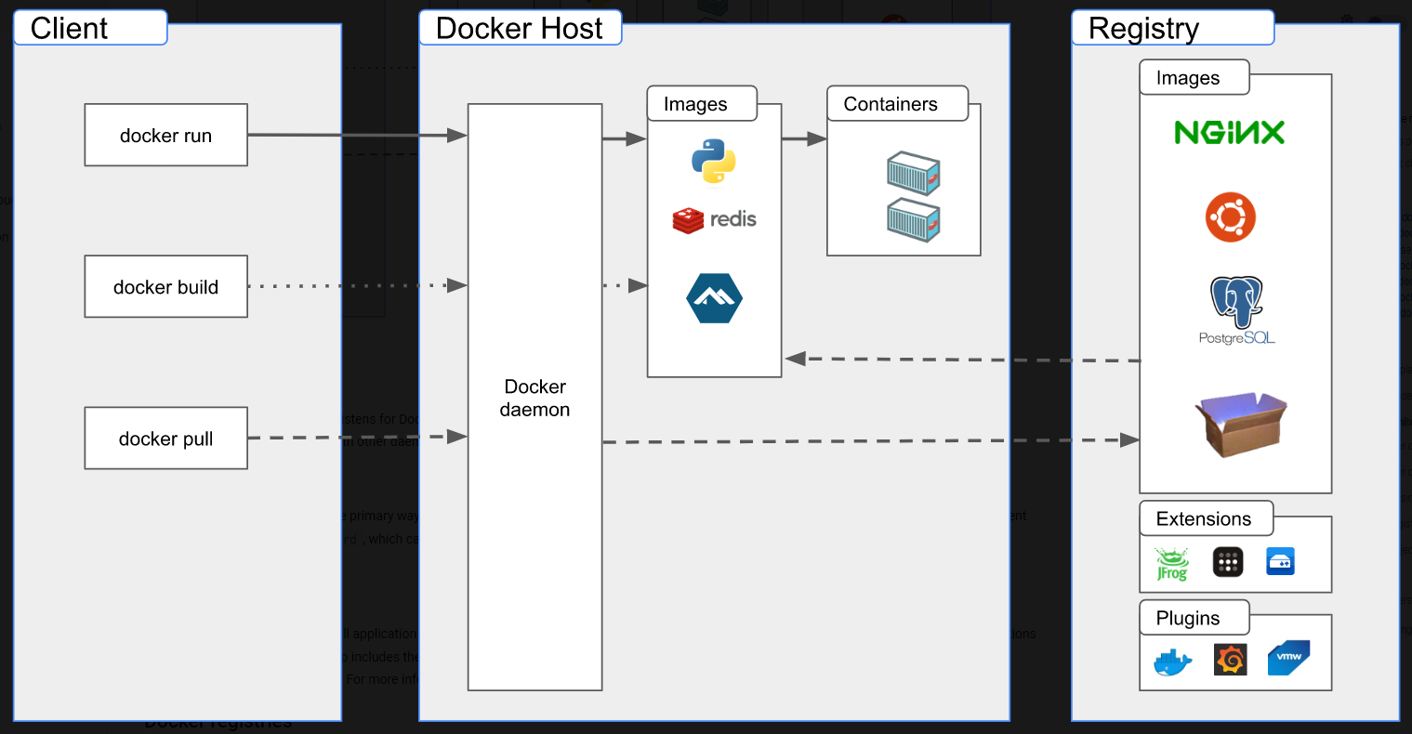
Architecture of Docker
https://docs.docker.com/get-started/overview/

Slide 16
Docker Host- machine, where docker is installed.
Docker daemon- dockerd, it listens to the command coming from docker client, and also it manages the objects of docker(like images, containers, network, volumes). It also communicates with other services present in docker registry.
Docker client -The Docker client (docker) is the primary way that many Docker users interact with Docker. When you use commands such as docker run, the client sends these commands to dockerd, which carries them out. The docker command uses the Docker API. The Docker client can communicate with more than one daemon.
Registry-
A Docker registry stores Docker images. Docker Hub is a public registry that anyone can use, and Docker is configured to look for images on Docker Hub by default. You can even run your own private registry.

Slide 17
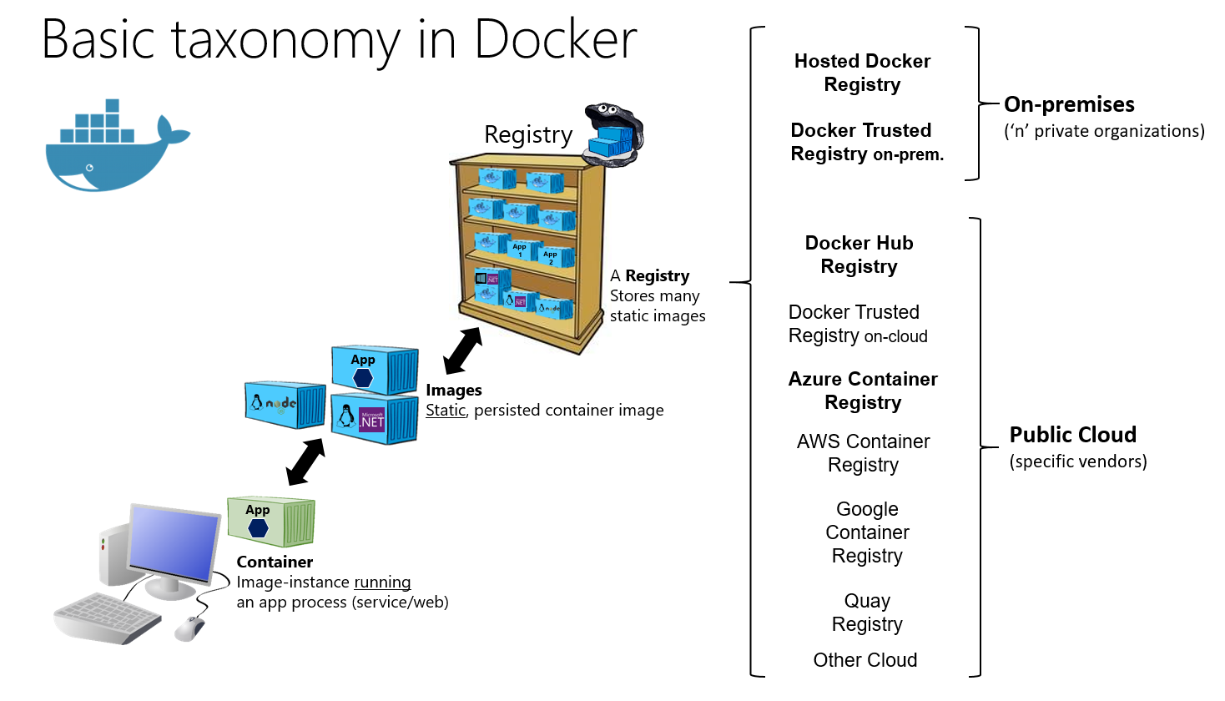

Slide 18
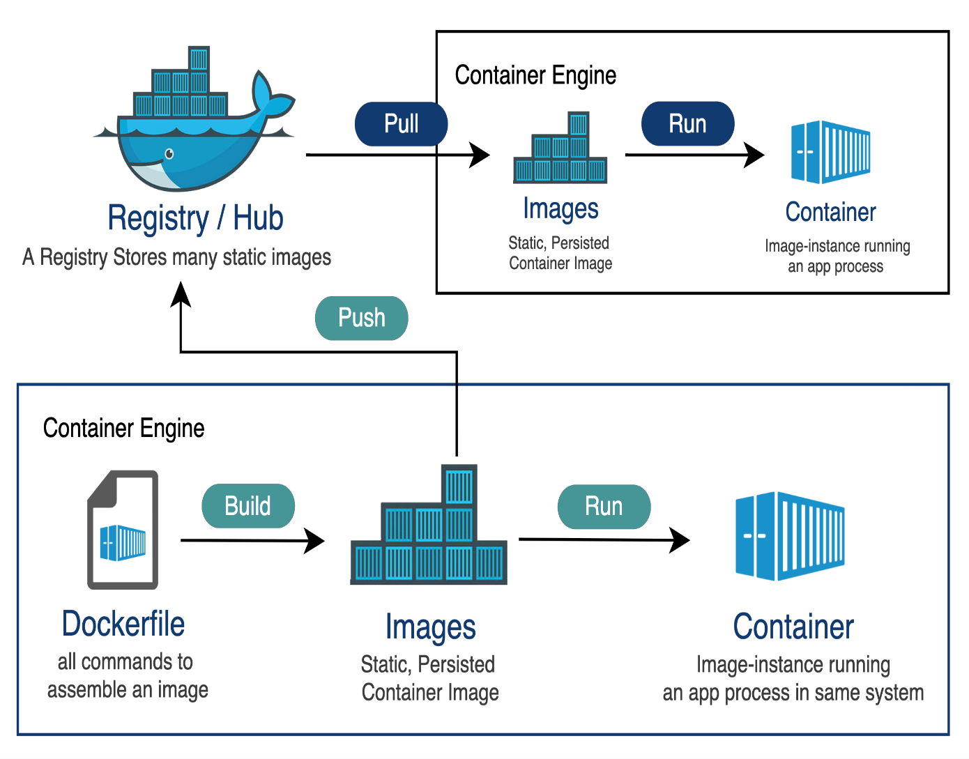
https://hub.docker.com/
https://labs.play-with-docker.com/

Slide 19
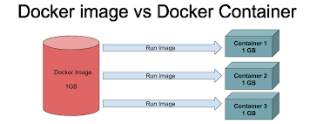
Images
An image is a read-only template with instructions for creating a Docker container.
Often, an image is based on another image, with some additional customization. For example, you may build an image which is based on the ubuntu image, but installs the Apache web server and your application, as well as the configuration details needed to make your application run.
Images are read-only.
You might create your own images or you might only use those created by others and published in a registry.
To build your own image, you create a Dockerfile with a simple syntax for defining the steps needed to create the image and run it.
Each instruction in a Dockerfile creates a layer in the image.
When you change the Dockerfile and rebuild the image, only those layers which have changed are rebuilt.
This is part of what makes images so lightweight, small, and fast, when compared to other virtualization technologies.

Slide 20
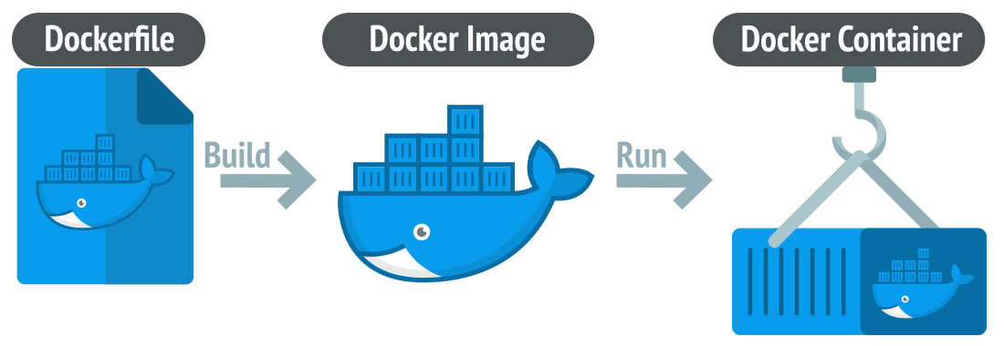
What is a container?
Simply put, a container is a sandboxed process on your machine that is isolated from all other processes on the host machine. That isolation leverages kernel namespaces and cgroups, features that have been in Linux for a long time. Docker has worked to make these capabilities approachable and easy to use. To summarize, a container:
Is a runnable instance of an image. You can create, start, stop, move, or delete a container using the DockerAPI or CLI.
Can be run on local machines, virtual machines or deployed to the cloud.
Is portable (can be run on any OS).
Is isolated from other containers and runs its own software, binaries, and configurations.
What is a container image?
When running a container, it uses an isolated filesystem. This custom filesystem is provided by a container image. Since the image contains the container’s filesystem, it must contain everything needed to run an application - all dependencies, configurations, scripts, binaries, etc.
The image also contains other configuration for the container, such as environment variables, a default command to run, and other metadata.

Slide 21
https://hub.docker.com/_/mysql
https://docs.docker.com/engine/reference/builder/#:~:text=A%20Dockerfile%20is%20a%20text,can%20use%20in%20a%20Dockerfile%20.
ALT+Enter -> to switch between full screen and small screen
Ctrl+insert ->copy
Ctlr+Fn+E->copy
Ctrl+shift+V->paste
Shift+insert ->paste
Container1
runningUserApp Image
IP- 168.192.1.0
Run command
UserApp Image
Container2
runningUserApp Image
Run command
IP- 168.192.1.2
Run command
Container3
runningUserApp Image
IP- 168.192.1.3

Slide 22
Docker Container Lifecycle
run
created
running
paused
create
start
pause
unpause
rm
stop
start
Deleted
stopped
rm

Slide 23
CODE # | NAME | WHAT IT MEANS
Exit Code 0 | Purposely stopped | Used by developers to indicate that the container was automatically stopped
Exit Code 1 | Application error | Container was stopped due to application error or incorrect reference in the image specification
Exit Code 125 | Container failed to run error | The docker run command did not execute successfully
Exit Code 126 | Command invoke error | A command specified in the image specification could not be invoked
Exit Code 127 | File or directory not found | File or directory specified in the image specification was not found
Exit Code 128 | Invalid argument used on exit | Exit was triggered with an invalid exit code (valid codes are integers between 0-255)
Exit Code 134 | Abnormal termination (SIGABRT) | The container aborted itself using the abort() function.
Exit Code 137 | Immediate termination (SIGKILL) | Container was immediately terminated by the operating system via SIGKILL signal
Exit Code 139 | Segmentation fault (SIGSEGV) | Container attempted to access memory that was not assigned to it and was terminated
Exit Code 143 | Graceful termination (SIGTERM) | Container received warning that it was about to be terminated, then terminated
Exit Code 255 | Exit Status Out Of Range | Container exited, returning an exit code outside the acceptable range, meaning the cause of the error is not known

Slide 24
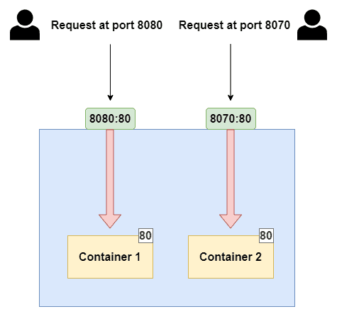
Port Mapping in Docker
In Docker, a container is an isolated environment that runs applications and services, similar to a physical or virtual machine. Just like these machines, containers have their own set of ports.
However, by default, these ports are not directly accessible from outside the container. This is where port mapping, also known as port forwarding, comes into play.
Port mapping allows you to expose the ports within a Docker container, making the services running inside the container accessible to the host system or to other containers within the Docker environment.

Slide 25
Port: Ports are numeric identifiers used to differentiate between different network services running on the same host. Ports are categorized into two groups: well-known ports (ranging from 0 to 1023) and dynamic or private ports (ranging from 1024 to 49151). Well-known ports are reserved for commonly used services like HTTP (port 80) and HTTPS (port 443).
Host Port vs. Container Port:
Host Port: This is a port on the host system, which is the machine where Docker is running. The host port is used to access the service or application running inside the Docker container from the host machine or from external systems.
Container Port: This is the port on which the service or application inside the Docker container is listening. It may be a specific port required by the application, for example, a web server listening on port 80.
Dynamic Mapping: If you omit the host_port, Docker will automatically assign an available host port. This is useful when you want to avoid port conflicts on the host system.

Slide 26
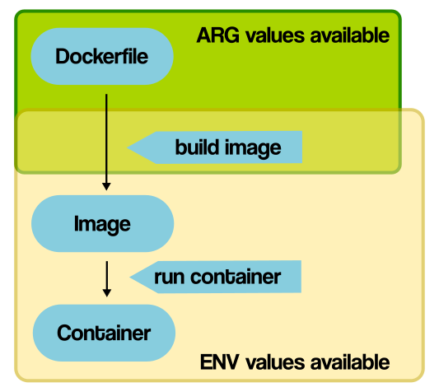
ARG and ENV
- ARG parameters are used only during the docker image building process
Unavailable once the image build
The running containers can not access the arg values
Eg. Version of the base image, version of library
We can specify the default value and while building image we can modify it
ENV variables can be passed during image build and also while running containers
ENV variable are used for database URLs, secret keys, API keys
We can modify value of ENV variables like ARG values

Slide 27
#using ARG in Dockerfile of Helloworld project
ARG javaVersion=17
FROM openjdk:${javaVersion}
ADD SingleContainerApp-0.0.1-SNAPSHOT.jar test.jar
ARG exposePort=8080
EXPOSE ${exposePort}
ENTRYPOINT ["java" ,"-jar" ,"test.jar"]

Slide 28
upload the jar file of ur project and the Dockerfile
to check files are uploaded or not
$ls
once the file are uploaded then build command to build change
$docker build --help
$docker build . -t hello-app:v1
here v1 is the tag name and hello-app is the image name
to get the images
$docker images
once the hello-app image is available we can run it
$docker run --name hello-container -d -p 8082:8080 hello-app
--name to give name to container, -d to run in detach or background,
-p to publish the port, 8082 is host port and 8080 is application/container port
to tag image from local to remote repo
docker tag local-image:tagname new-repo:tagname
$docker tag hello-app:v1 hello-remote:v1
this will show local and remote image
$docker images
to push image on docker hub repository first login to docker
$docker login
$docker push hello-remote:v1

Slide 29
Volumes and Mounts
Host
Container
Bind mount
tmpfs mount
Volume
File System
Memory
Docker Area

Slide 30
Docker 2 options for data persistence
Volumes
Volumes are directories or files that outside the union file system.(a combination of the read-only layers on top of containers)
Volumes store the files on the host file system.
Volumes are always inside the ‘ /var/lib/docker/volumes’ directory
Mounts-
Bind mounts-
a file or folder stored anywhere on the container host filesystem and mounted into a running container is called a bind mount
They can be anything from essential system files to directories
Docker or non-docker processes on the docker host can modify the mounts at any time
tmpfs mounts
These are used by docker running on Linux system.
The storage is inside host systems only.
We never write the tmpfs mounts on the host system’s filesystem.
Contrary to volumes and bind mounts tmpfs mounts are temporary and only persisted inside host memory.
When the container stops , the tmpfs mount removes . And files written there won’nt persisted.
If the docker is running on Windows, we can use the named pipe

Slide 31
Secrets in Docker
Secrets provide a mechanism to securely store data that can be read by applications at runtime.
Secrets are created and managed separately from the application
docker secrets are only available to swarm services
This means stand-alone containers can not access the secrets, therefore to use the secrets , we must configure our cluster for swarm

Slide 32
Docker networking – it refers to ability for containers to connect and communicate with each other, or to the no-docker workloads.
It’s a communication package that allows isolated docker containers to communicate with one another to perform required tasks.
Flexibility
Cross-platform - swarm clusters
Scalability
decentralized
Network sandbox
Network sandbox
Network sandbox
Container 1
Container 2
Container 3
endpoint
endpoint
endpoint
endpoint
Network
Network
Docker Engine
Network driver
Network Infrastructure

Slide 33
Bridge Network driver
This id default network
host
Web-app
178.57.5.3
Db
178.23.0.3
8085
Test-bridge nw
External network 8000

Slide 34
Docker daemon host
Docker daemon host2
Root-app-1
Root-mysqldb-1
Root_default bridge nw
Default bridge
c2
c1
c2

Slide 35
Host network driver-
It removes the network isolation between the containers and docker host. Due to this the containers can directly use the host’s networking once isolation is removed.
host
Web-app
178.57.5.3
Db
178.23.0.3
8085
Host nw
External network 8085

Slide 36
Bridge Network driver
This id default network
None network- container is not attached or associated with any container , when the driver in ‘none’.
In this case the containers also do not have access to any other container or external network.
When we want to disable networking stack for a container and have loopback device then we can use this type of network .
Host network driver-
It removes the netwrk isolation between the containers and docker host. Due to this the containers can directly use the host’s networking once isolation is removed.
Overlay network-
It is used with swarm cluster

Slide 37
Get all images | docker images
Get all the running containers | docker ps
Get list of all container | docker ps -a
To start the container which is in exited state | docker container start name-of-container / docker start name-of-container
To stop a container | docker stop name-of-container
To pause the running container | Docker pause name-of-container
To unpause the container | Docker unpause name-of-container
To restart the container | Docker restart name-of-container
To block a container | Docker wait name-of-container
To save the running container as an image | Docker commit –m “commit message” –a “author” name-of-container Username/image-name:tag
To get container logs | Docker logs name-of-container
To run commands in container | Docker exec –it name-of-container bin/bash
To get low-level information about the container | Docker inspect name-of-container
To show container resource usage statistics | Docker stats name-of-container

Slide 38
To show all running processes in the existing container | Docker top name-of-container
To remove stopped container | Docker rm name-of-container
To remove running container | Docker rm –f name-of-container
To remove all stopped containers | Docker rm $(docker ps –a -q)
To stop all containers | Docker kill $(docker ps -q)
To create a container from image | docker container create name-of container -p 8080:80 image-name Port mapping is optional, mention for nginx image
To remove image | Docker image rm image-name / docker rmi image-name - If no running container associated with it Docker image rm –f image-name / docker rmi –f image-name - If running container associated with it
To display the image history | Docker image history image-name
To display details about the image | Docker inspect image-name
To build an image from dockerfile present in current directory | Docker build . Image repository and tag will not be assigned
To tag a image | Docker tag image-id repo:tagname Docker tag 76fd6 demo:v1
To build and tag image | Docker build –t imagename:tagname .

Slide 39
-d, --detach with container | Runs a container in background, and prints container ID
--env , -e with container | Set environment variable
--name with container | Assign name to the container
-p , --publish | Publish a container's port(s) to the host
--network with container | To attach a network to the container
Log in to the registry | Docker login
Logout in to the registry | Docker logout
Pull image from a registry | Docker pull image-name
Push image on docker-registry | Docker push image-name
To create a network/default network will be created that is bridge | Docker network create network-name
To create network with specified type | Docker network create –d type-of-network network-name
To list all network | Docker network ls
To remove a network | Docker network rm networkname

Slide 40
To assign network while creating container, this assigns only one network | Docker run –name container-name –network network-name –d image-name
To connect network to existing container, it adds another network in addition to the existing network | Docker network connect network-name container-name
To disconnect network from container | Docker network disconnect network-name container-name
To display detailed information about a network | Docker network inspect network-name
To create a volume | Docker volume create vol-name
To display list of volumes | Docker volume ls
To display detailed info about volume | Docker volume inspect vol-name
To remove volume | Docker volume rm vol-name
To remove all unused volumes | Docker volume prune
To attach volume while creating and running container Source=volume name and target= container path, incase of volume mount | docker run –name container-name --mount source=test2,target=/var/lib -d nginx
To attach bind mount volume | docker run --mount type=bind,source=/root/test3,target=/var/lib -d nginx

Slide 41
To start swarm mode as manager | Docker swarm init –advertise—addr 192.168.00.121
To join the swarm mode from other nodes | Docker swarm join
To get list of nodes | Docker node ls
To Display system-wide information | Docker info / docker system info
To rename container | Docker rename old-name new-name

Slide 42
Kubernetes
Overview Kubernetes – Pods, node, cluster, namespaces
Pod creation (Imperative and Declarative)
Deployment Creation
Replica Sets
Config Maps, secrets
Network
Service Creation
Deployment strategy(Canary and Blue-Green Strategy)
Helm Overview

Slide 43
Kubernetes- https://kubernetes.io/
K8s
Open source system for automating, scaling, deployment and management of containerized application
Orchestration platform, which will automate the manual process of deploying , scaling, managing the containerized application
Docker Swarm- container orchetstration tool, that is provided by docker,
Kubernetes has its own unique set of Api client, also YAML definition used to managed in k8s.
In docker it used CLI for managing containers.
Logging and monitoring- K8s has its own built in tools, while the docker swarm needs to depend on third party tool
Scalling is better in K8s than Docker swarm

Slide 44
Container
Container
Container
Web Service
Database Service
Messaging Service
Libraries/Bin/Dependencies
Libraries/Bin/Dependencies
Libraries/Bin/Dependencies
Docker
OS Ubuntu
Linux Kernel
Hardware

Slide 45
Kubernetes
Node 1
Kubernetes
Node 2
Kubernetes
Node 3
Container
Container
Container
Web Service
Database Service
Messaging Service
Libraries/Bin/Dependencies
Libraries/Bin/Dependencies
Libraries/Bin/Dependencies
Orchestration

Slide 46
Nodes(Minions)
Physical or virtual machine with k8s installed on it>
Kubernetes runs your workload by placing containers into Pods to run on Nodes. Depending on the cluster, a node may be a virtual or physical machine. Each node is managed by the control plane and contains the services necessary to run Pods.
Typically you have several nodes in a cluster; in a learning or resource-limited environment, you might have only one node.
CPU
RAM
Node101

Slide 47
CPU
RAM
Node105
Cluster-
Set of nodes grouped.
If one node fails app still accessible from the other nodes
Having more than one node helps in sharing the load.
CPU
RAM
Node101
Cluster
CPU
RAM
Node103
CPU
RAM
Node102
CPU
RAM
Worker node
Node 1
Customer App
Node 2
Customer App
Node 3
Customer App
Node 4
Customer App
deployment
pods
containers
creates
creates

Slide 48
Who is responsible for managing cluster?
Where the information about the members of cluster is stored?
How are the nodes monitored?
Master node Is another node with k8s installed on it and configured as Master.
Mastre watches watches over the other nodes in cluster and responsible for the orchestration of the container on worker nodes
Master Node
Kubernetes
Node 1
Customer App
Kubernetes
Node 2
Customer App
Kubernetes
Node 3
Customer App
Kubernetes
Node 4
Customer App
Kubernetes

Slide 49
Cluster
Kubernetes
Node 1
Kubernetes
Node 2
Kubernetes
Node 3
Container
Pod1
Pod2
Pod
Pod
Web Service
Web Service
Web Service
Web Service
Container
Container
Container
Container
Libraries/Bin/Dependencies
Libraries/Bin/Dependencies
Libraries/Bin/Dependencies
Libraries/Bin/Dependencies
Container
Container
Orchestration

Slide 50
IP
Pods are the smallest deployable units of computing that you can create and manage in Kubernetes.
A Pod (as in a pod of whales or pea pod) is a group of one or more containers, with shared storage and network resources, and a specification for how to run the containers. A Pod's contents are always co-located and co-scheduled, and run in a shared context.
A Pod models an application-specific "logical host": it contains one or more application containers which are relatively tightly coupled. In non-cloud contexts, applications executed on the same physical or virtual machine are analogous to cloud applications executed on the same logical host.
As well as application containers, a Pod can contain init containers that run during Pod startup.
Cluster→ Nodes→ Pods→ one or more containers of same or different types of images running in it.
POD
c1
c2
c4
c3
volume

Slide 51
One to One Relation of Pod and Container in case of same application
Multi Container Pod approach
Pod
Worker Node
Pod
Container
Container
Container
Nginx- container
Nginx- container
Nginx- container
Multiple Pod approach
Worker Node
Pod
Pod
Container
Container
Nginx- container
Nginx- container

Slide 52
Multi Container Pod approach
Pod
Container
Container
User container
Supporting container
Multiple Pod approach
Worker Node
Pod
Pod
Container
Container
Nginx- container
Nginx- container

Slide 53
Node
IP
POD1
c1
c2
c1
IP
POD3
volume
c1
c2
c1
IP
POD2
volume
c1
c2
c1
volume
kubelet
Container runtime (Docker)

Slide 54
Deployment with Replicas=3
IP
IP
IP
POD
POD
POD
c1
c1
c1
c2
c2
c2
c4
c4
c4
c3
c3
c3

Slide 55
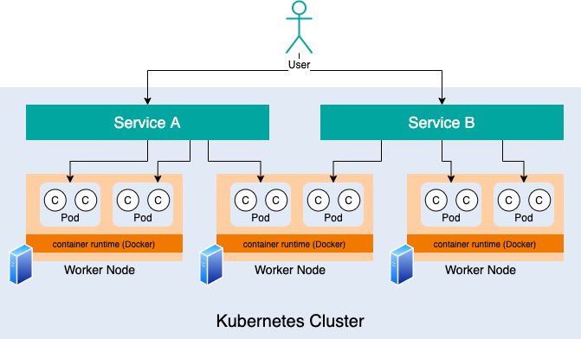
Who is going manage the clusters?
Where information about the nodes/ members of the cluster is stored?
Or how the nodes will be monitored?
Who will monitor the failed nodes?
How the workload if failed node will move to another node?

Slide 56
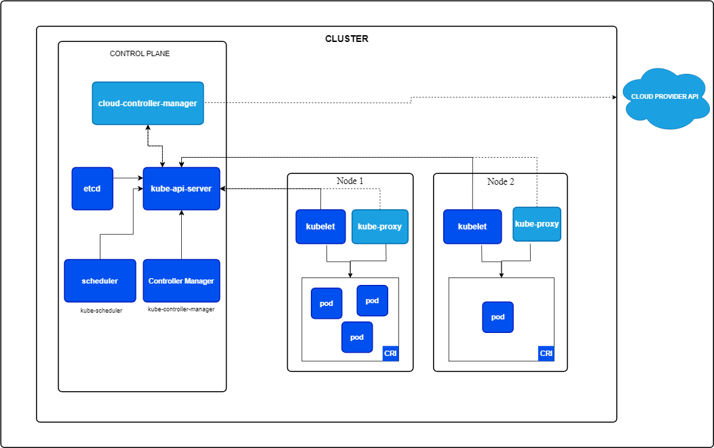

Slide 57
Worker Node
Master Node

Slide 58
Control Plane-
It makes the global decision of cluster
It can be said as head or master node, as it manages the nodes and pods in the cluster
Worker Node-
Its compute node, where containerized application runs
Pods are scheduled and orchestrated to run on nodes.
we can scale up or scale down the nodes in cluster
API Server/Kube-api server
Works as front end for k8s
It can track the states of all the cluster components, also manages the interaction between clusters
It also consumes YAML and JSON manifest files.
It also processes and validates the requests made via API.
The main implementation of a Kubernetes API server is kube-apiserver. kube-apiserver is designed to scale horizontally—that is, it scales by deploying more instances.
You can run several instances of kube-apiserver and balance traffic between those instances.

Slide 59
Scheduler
Distribute the workload among the multiple nodes
Control plane component that watches for newly created Pods with no assigned node, and selects a node for them to run on.
Factors taken into account for scheduling decisions include: individual and collective resource requirements, hardware/software/policy constraints, affinity and anti-affinity specifications, data locality, inter-workload interference, and dead
Controller-
Logically, each controller is a separate process, but to reduce complexity, they are all compiled into a single binary and run in a single process.
Some types of these controllers are:
Node controller: Responsible for noticing and responding when nodes go down.
Job controller: Watches for Job objects that represent one-off tasks, then creates Pods to run those tasks to completion.
EndpointSlice controller: Populates EndpointSlice objects (to provide a link between Services and Pods).
ServiceAccount controller: Create default ServiceAccounts for new namespaces

Slide 60
cloud-controller-manager
A Kubernetes control plane component that embeds cloud-specific control logic. The cloud controller manager lets you link your cluster into your cloud provider's API, and separates out the components that interact with that cloud platform from components that only interact with your cluster.
The cloud-controller-manager only runs controllers that are specific to your cloud provider.
If you are running Kubernetes on your own premises, or in a learning environment inside your own PC, the cluster does not have a cloud controller manager.
Etcd- it stores/persists the information about all the nodes
It is distributed storage, also uses the/etc folder of unix
Kubelet-
It is an agent that runs on each node in the cluster
It makes sure the containers are running in pod and they are healthy
It instantiates and executes the pod
It also watches the API server for work
It follows the instruction of master node
Kube-proxy
It is network proxy that runs on each node in the cluster, implementing the part of k8s service
These network rules allow network communication to your Pods from network sessions inside or outside of your cluster
Container runtime-
It is sw responsible for running container in pods
Each worker node contains a runtime engine, which pulls the images from a container registry, and starts and stop the containers.
Eg. Docker, conatinerd, CRI-O

Slide 61
Namespace-
Dev Namespace
Staging Namespace
Production Namespace

Slide 62
Namespace
default
Kubernetes includes this namespace so that you can start using your new cluster without first creating a namespace.
kube-node-lease
This namespace holds Lease objects associated with each node. Node leases allow the kubelet to send heartbeats so that the control plane can detect node failure.
kube-public
This namespace is readable by all clients (including those not authenticated). This namespace is mostly reserved for cluster usage, in case that some resources should be visible and readable publicly throughout the whole cluster. The public aspect of this namespace is only a convention, not a requirement.
kube-system
The namespace for objects created by the Kubernetes system.

Slide 63
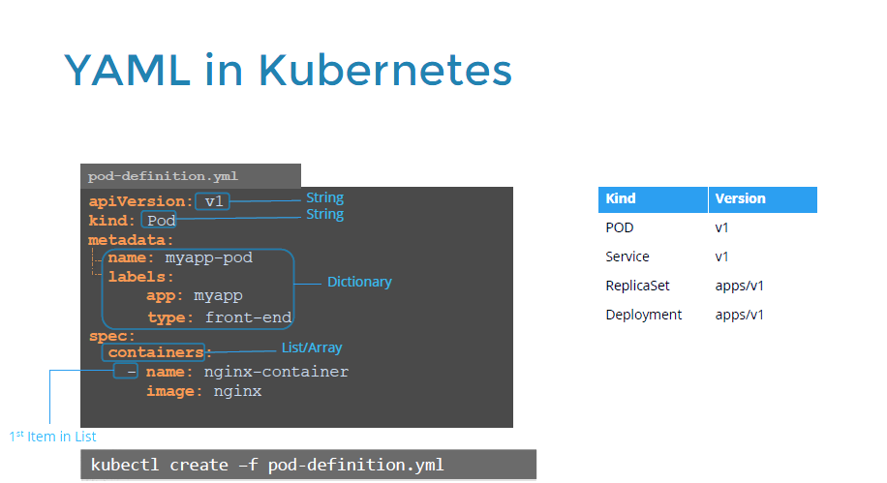

Slide 64
App:V1
App:V1
App:V1
App:V1
App:V1

Slide 65
App:V2
App:V1
App:V1
App:V1
App:V1

Slide 66
Replication Controller and Replica Sets-
Replication Controller is an older technology replaced by Replica Sets, apiversion will be v1
In replicaSet apiVersion = apps/v1
Deployment- process of providing the declarative updates to pods and replicas ets
It allows users to declare the desired state in the yaml file and the controller will change the current state to declared state
Two deployment strategies are available- Rolling Update and recreate

Slide 67
Deployment- process of providing the declarative updates to pods and replicasets
It allows users to declare the desired state in the yaml file and the controller will change the current state to declared state
Two deployment strategies are available- Rolling Update and recreate
Deployment ultimately creates the pods
Default strategy in deployment-Rolling Update Strategy

Slide 68
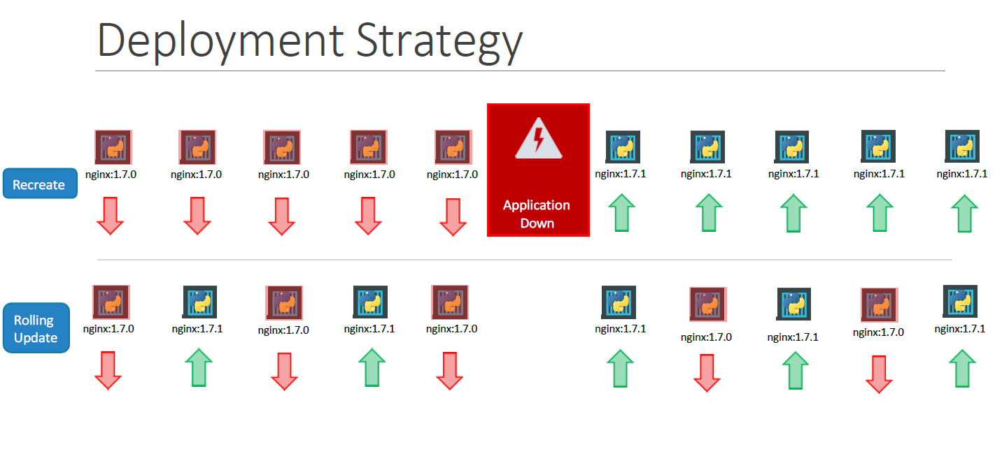

Slide 69
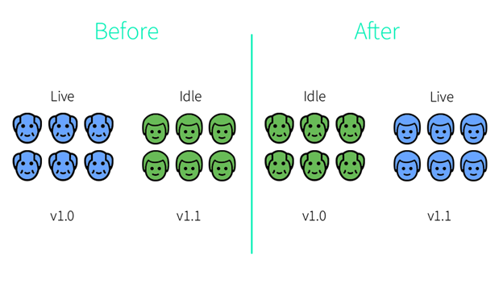
Blue Green Deployment

Slide 70
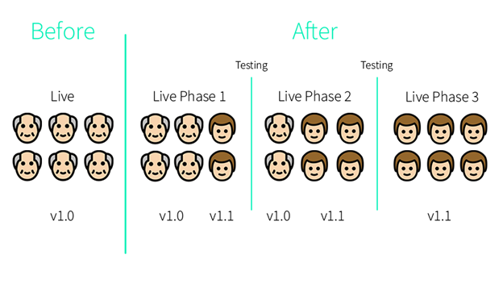
Canary Deployment

Slide 71
Networking in K8s
Node
192.168.1.2
Internal Private Network
10.244.0.0
10.244.0.3
Pod1
10.244.0.2
Pod2
10.244.0.4
Pod3

Slide 72
192.168.1.2
192.168.1.3
Node
Node
Internal Private Network
10.244.0.0
Internal Private Network
10.244.0.0
10.244.0.3
Pod1
10.244.0.3
Pod2

Slide 73
user
Service - enables the network access to the set of pods
192.168.1.10
Service
Service selects pod based on labels
Node – 192.168.1.2
Pod 1
10.244.0.2
Pod 2
Pod 3
Deployment nginx

Slide 74
Service
Used to expose the application deployed on set of pods using a single endpoint
Provides reliable networking by adding the stable IP address And DNS to pods
Types-
Cluster IP
NodePort
LoadBalancer
ExternalName
Service
K8s assign IP to svc
Pod
Pod
Pod
Pod

Slide 75
Front-End Pods
Pod1
IP Address 1
Pod2
IP Address 2
Pod3
IP Address 3
Back-End Service
Back-End Pods
Pod1
IP Address 1
Pod2
IP Address 2
Pod3
IP Address 3
Database Service
Database Pods
Pod1
IP Address 1
Pod2
IP Address 2
Pod3
IP Address 3

Slide 76
Cluster IP
Defult service and most common service type
K8s assign an internal cluster ip address to the ClusterIP service
This makes the service available the service within the cluster
Due to this we can not make the request to service(pod) from outside of the cluster
Used inter-service communication within the cluster
E.g. communication between front –end and back-end components of application
Front-End Pods
Pod1
IP Address 1
Pod2
IP Address 2
Pod3
IP Address 3
Back-End Service
Back-End Pods
Pod1
IP Address 1
Pod2
IP Address 2
Pod3
IP Address 3
Cluster
Traffic
Database Service
Database Pods
Cluster IP service-my-cs
Pod1
IP Address 1
Pod2
IP Address 2
Pod3
IP Address 3
Pod
Pod
Pod
Pod

Slide 77
Traffic
Nodeport service-
This is and extension to the ClusterIP service
It exposes the service outside of the cluster by adding a cluster–wide port on the top ClusterIP service
To access service from the outside cluster, by requesting NodeIP:NodePort
Node Port range, 30000-32767
We can assign the port to a service or in case of undefines, k8s will assign it automatically
When you want the external connectivity to your service
Cluster
Node Port 30008
NodePort Service
Service, Port=5678,
IP
Target port=80
Pod
IP1
Pod
Pod
Pod

Slide 78
Traffic
LoadBalancer service-
This is and extension to the NodePort service
It exposes the service externally using cloud provided load balancer
Traffic from the external load balancer is directed at the backend pods then cloud provider decides how it is load balanced
The actual creation of load balancer happens asynchronously
It used if you are using the cloud provider to host your k8s cluster
Cluster
LoadBalancer Service
Service, Port=5678, IP
Pod
Pod
Pod
Pod

Slide 79
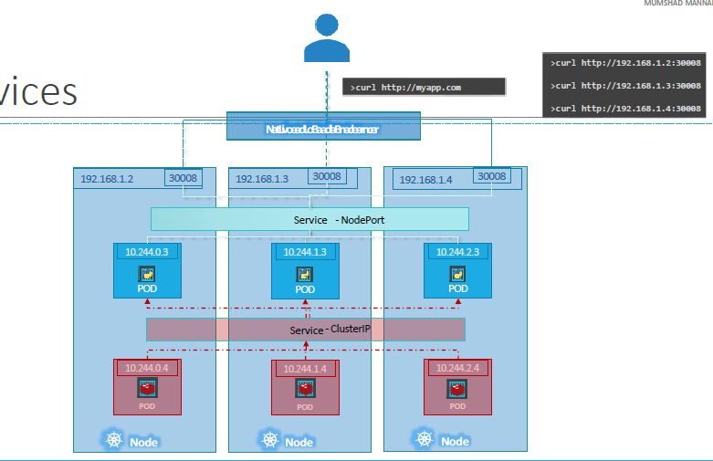
LoadBalancerService

Slide 80
Headless Service-
When there is no need of load balancing or single service IP address.

Slide 81
ExternalName service-
To be able to access and application that lives outside of a k8s cluster , then we use externalName service
It gives more flexibility to access the external application
External application
Database.external.com
Cluster
ExternalName Service
Pod
Pod
Pod
Pod

Slide 82
apiVersion: v1
kind: Service
metadata:
labels:
app: testclusteripsvc
name: testclusteripsvc
namespace: default
spec:
clusterIP: 10.102.14.243
clusterIPs:
- 10.102.14.243
internalTrafficPolicy: Cluster
ipFamilies:
- IPv4
ipFamilyPolicy: SingleStack
ports:
- name: 5678-8081
port: 5678
protocol: TCP
targetPort: 8081
selector:
app: demo
sessionAffinity: None
type: ClusterIP
status:
loadBalancer: {}
apiVersion: apps/v1
kind: Deployment
metadata:
name: demo-deployment
labels:
app: demo
spec:
replicas: 2
selector:
matchLabels:
app: demo
template:
metadata:
labels:
app: demo
spec:
containers:
- name: demo-container
image: snehal1672/demo-docker-repo:latest
ports:
- containerPort: 8081

Slide 83
Node 192.168.1.1
NodePort
Service
Your machine
Port range of node
30000-32767
192.168.1.2
Pod
10.244.0.0
NodePort Service

Slide 84
Blue-Green Deployment-
Zero downtime deployment, because in this type of deployment strategy, k8s is not going to delete or replace any existing pod, instead it create a new pod, in new environment along with existing deployment
Advantage- reduced downtime, immediate rollback
User
K8s CLuster
LoadBalancing Service
If selector is blue
If selector is green
Blue Deployment
Green Deployment
Pod 1
Pod N
Pod 1
Pod N

Slide 85
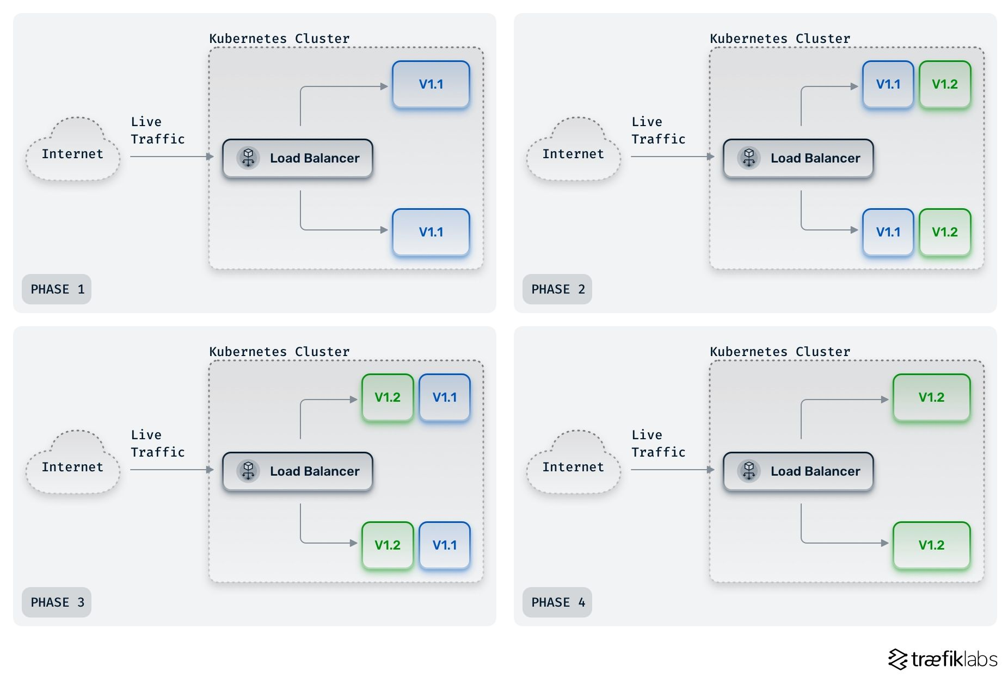

Slide 86
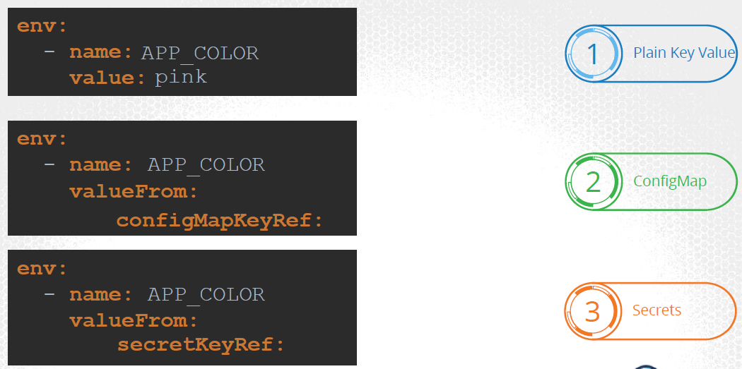

Slide 87
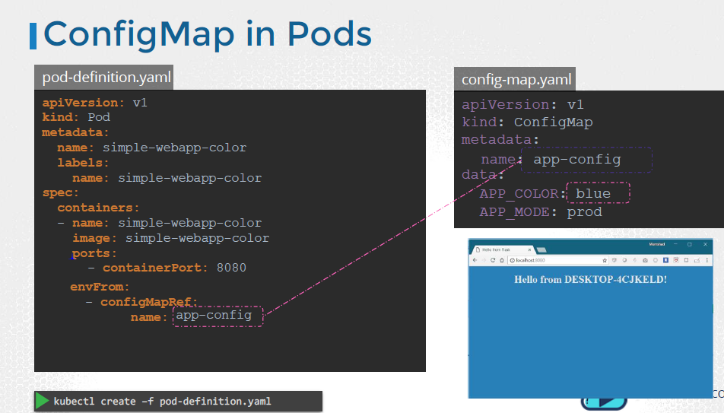

Slide 88
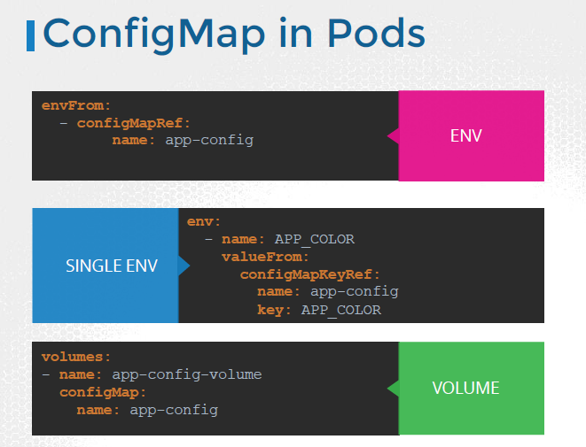

Slide 89
In Kubernetes, a PersistentVolume (PV) is a piece of storage in the cluster that has been provisioned by an administrator. It is a resource in the cluster just like a node is a cluster resource.
PVs are volume plugins like Volumes, but have a lifecycle independent of any individual Pod that uses the PV. This means that PVs persist beyond the lifetime of any individual Pod.
To convert plain text to secret
Password =root,
So ‘root’ need to encoded
So on linux-
Echo –n ‘root’ | base64
Cmdjfk256=

Slide 90
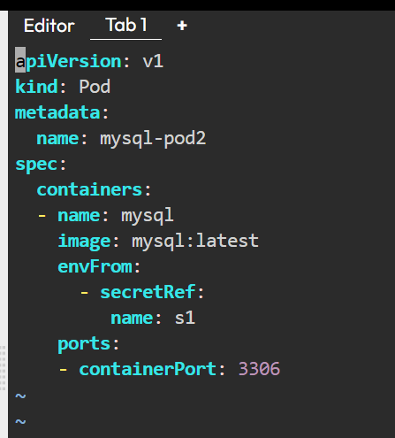
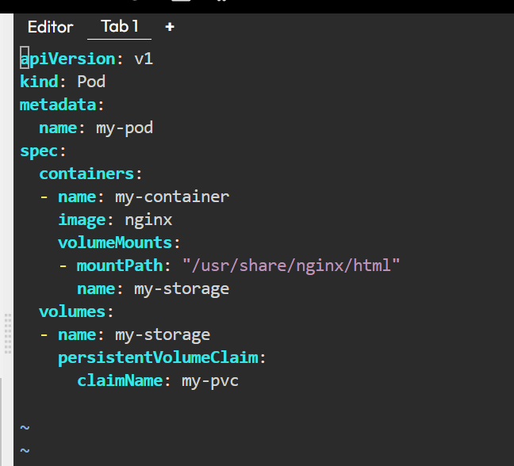

Slide 91
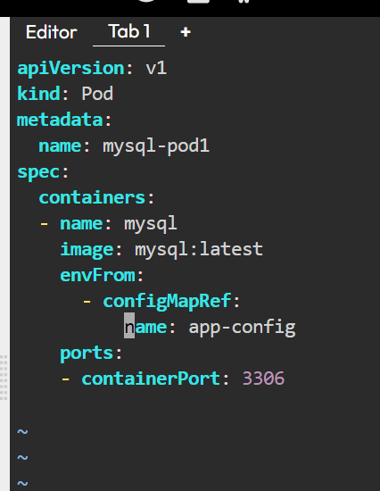
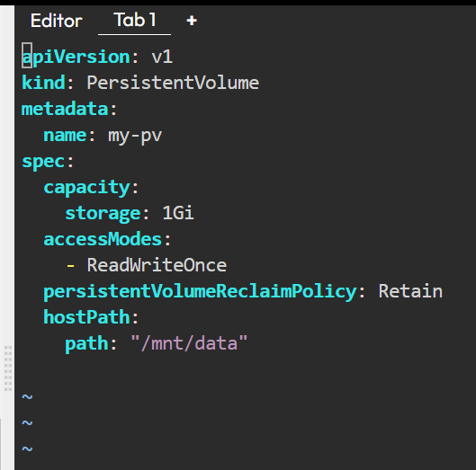
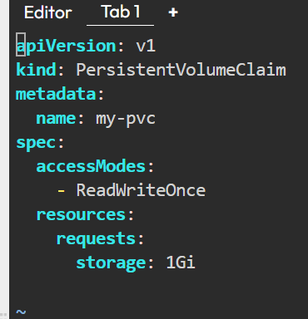

Slide 92
https://capgemini.udemy.com/course/azure-devops-for-beginners/
https://capgemini.udemy.com/course/web-application-security-for-absolute-beginners-no-coding/
https://owasp.org/www-project-top-ten/
OWASP Top Ten | OWASP Foundation
https://learn.microsoft.com/en-us/azure/devops/repos/git/clone?view=azure-devops&tabs=visual-studio-2022
Clone an existing Git repo - Azure Repos
Learn how to create a local clone of any remote Git repo using Visual Studio or the Git command line.
https://learn.microsoft.com/en-us/azure/devops/pipelines/get-started/pipelines-get-started?view=azure-devops
Use Azure Pipelines - Azure Pipelines
Learn the basics about Azure Pipelines and how to use it to automatically build and release code.
https://dev.azure.com/
Azure DevOps Services | Microsoft Azure

